Slide 2
Youth- CIT Trauma, ACES and Developmental Stages
Monica bellucci, M.ed, lmhc – western ma cit- ttac clinical coordinator
Lieutenant Christopher Bonnett - Montague Police department

Slide 3
Learning objectives
Participants will be able to identify childhood trauma and how that affects the child’s developing brain
Participants will gain knowledge on ACE’s (Adverse Childhood Experiences) and how it impacts all areas of functioning throughout a person's life span and puts individuals at a greater risk for criminal justice system involvement.
Participants will gain better understanding of the three stages of adolescent development and developmental milestones of adolescence
Participants will gain better understanding of generational trauma
Participants will understand practical skills on how to interact with youth when in a “crisis” state

Slide 4
The neocortex and “lizard brain” (review)
The cerebral cortex, the frontal cortex, is the front structure of our brain.
It contains most of our language abilities. This hemisphere of the brain processes information in an explicit, logical, analytical, and linear fashion.
It’s important for our functioning in a health lifestyle, that everything is integrated and linked.
This part of the brain is not fully developed until around age 25
The biggest growth period for brain growth is ages birth – 2 years, 12-18, 2-12
The Neocortex or “frontal lobe” goes “offline” in times of high stress

Slide 5
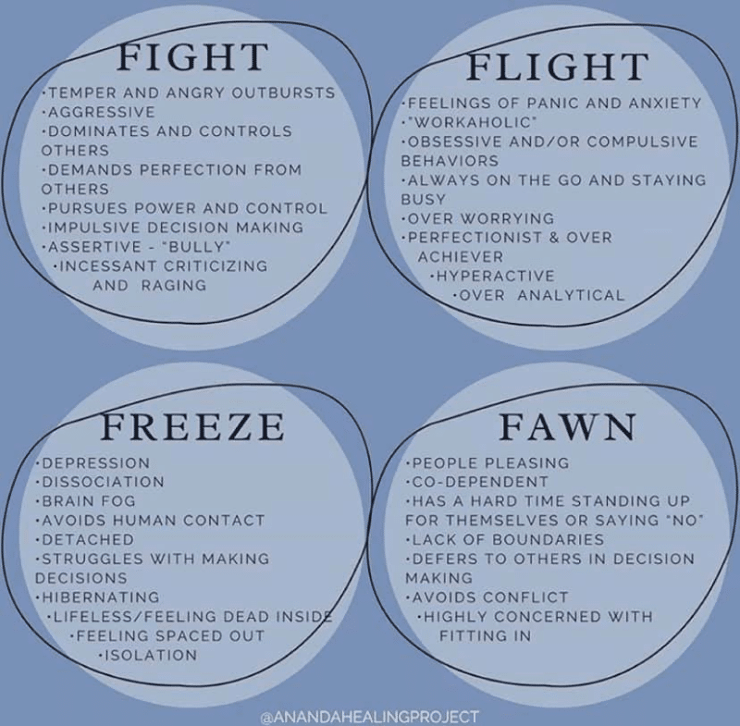
Trauma Responses
Flight
Flight
Freeze
Appease (Fawn)

Slide 6
What is traumatic is not always dramatic

Slide 7
What humans need for biological (species) survival
Food
Water
Shelter
Sex
Attachment/connection

Slide 8
Still face Experiment- Dr. Ed Tronick

Slide 9
Nadine Burke Harris “the well”

Slide 10
Adverse Childhood Experiences (ACES)Questionnaire
A household member swore at, insulted, humiliated, or put you down in a way that scared you OR a household member acted in a way that made you afraid that you might be physically hurt
Someone touched your private parts or asked you to touch their private parts in a sexual way that was unwanted, against your will, or made you feel uncomfortable
More than once, you went without food, clothing, a place to live, or had no one to protect you
Someone pushed, grabbed, slapped or threw something at you OR you were hit so hard that you were injured or had marks
You lived with someone who had a problem with drinking or using drugs You often felt unsupported, unloved and/or unprotected

Slide 11
Adverse Childhood Experiences (ACES) Questionnaire
At any point since you were born…
You have been in foster care
You have experienced harassment or bullying at school
You have lived with a parent or guardian who died
You have been separated from your primary caregiver through deportation or immigration

Slide 12
Adverse Childhood Experiences (ACES) Questionnaire
You have had a serious medical procedure or life-threatening illness
You have often seen or heard violence in the neighborhood or in your school neighborhood
You have been detained, arrested or incarcerated
You have often been treated badly because of race, sexual orientation, place of birth, disability or religion
You have experienced verbal or physical abuse or threats from a romantic partner (i.e. boyfriend or girlfriend)

Slide 13
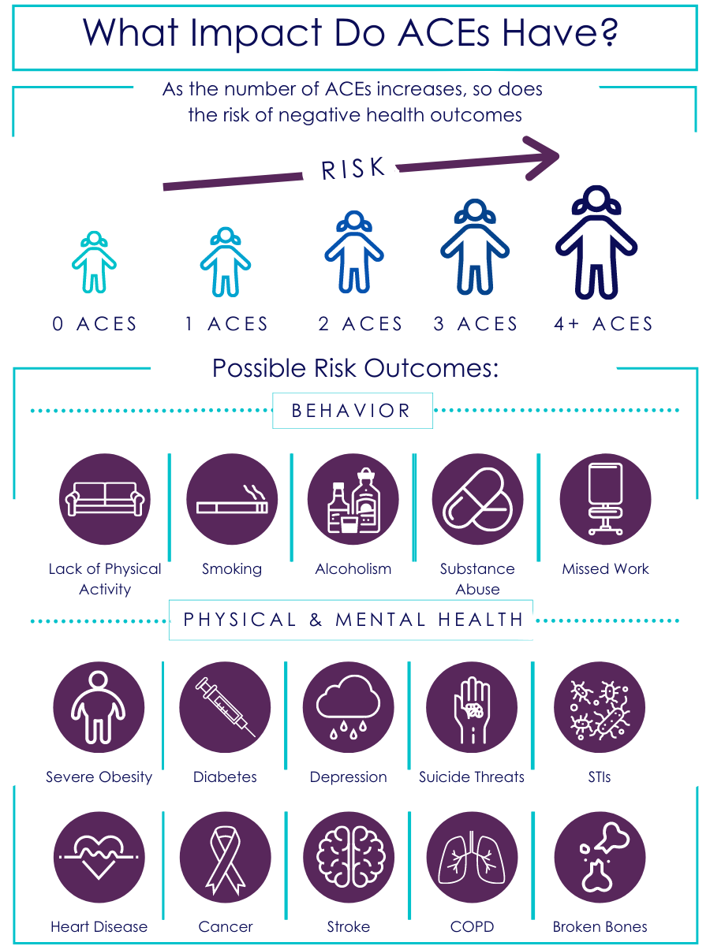

Slide 14
Break!!!!

Slide 15
Harlow’s Monkeys

Slide 16
How the developing brain response to repeated ongoing childhood trauma
The development and functioning of the three parts of the brain rely heavily on our childhood experiences. This includes early attachment figures, conditions in our environment, and traumas.
If we have ongoing or repeated threats in life, or on-going emotional/physical neglect, our brains become hypersensitive to cues that remind us of those traumatic experiences.
We can then have intense emotional reactions to cues, and our “lizard brain” will then automatically activate our survival/trauma response system

Slide 17
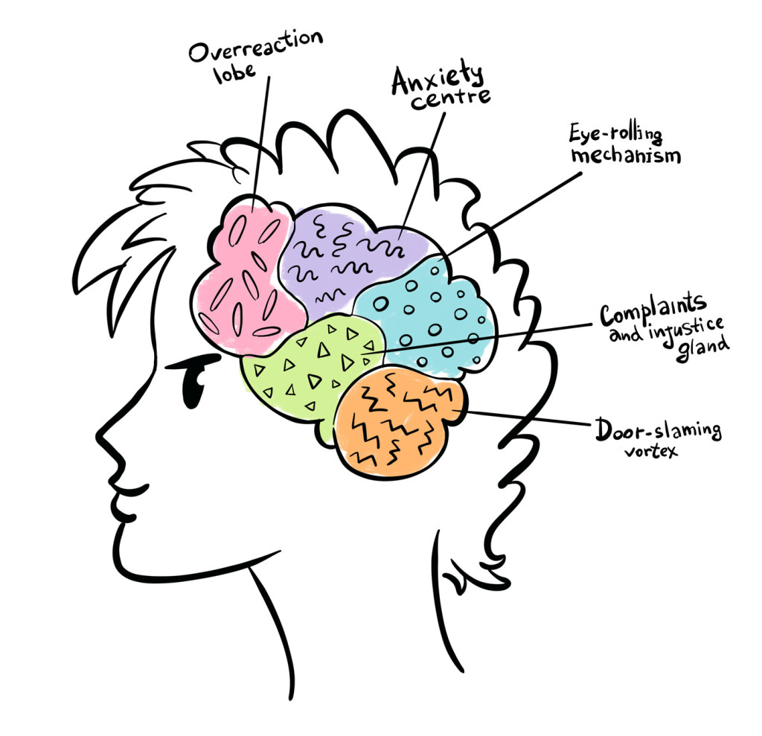
Trauma and the developing teenage brain
When our “lizard brain” is active, stress hormones (adrenaline and cortisol), are released and remain in a child or adolescence’s system and brain much longer than in adults (5-10 minutes for adults versus 1-2 hours for adolescents!)
These hormones drastically reduce, or block, the brain’s ability to access the Pre-Frontal Cortex, the rational-thinking part. They are “offline”
Biologically speaking, when stressed, teenagers are not nearly as able to think through situations rationally as adults are.

Slide 18
Adolescents are NOT “mini adults”
Early Adolescence (10-13 years old)
Middle Adolescence (14-17 years old)
Late Adolescence/Young Adult (18-21 years old)

Slide 19
Early adolescence (10-13 years old)
Puberty starting
May start questioning their sexuality/gender
Increase sexual interest begins
Body changes start to evoke both curiosity and anxiety

Slide 20
Early adolescence (10-13 years old)
Cognitive development at this stage
More concrete and “black and white”, “all or nothing” thinking. Limited capacity for abstract thought.
Start to become more socially aware and become more self conscious about their appearance
Start to develop deeper moral thinking
Starting to express more independence, more need for privacy and start to react more strongly when limits are enforced

Slide 21
Middle adolescence (14-17 years old)
Puberty and sexual interests and desire continue to grow
Less time wanting to spend with family, increased need to spend time with friends
Increased need for independence and pushing back against parents and authority figures, while at the same time increased need for peer/social interdependence
Emotions and impulses drive many decision-making experiences (foot is on the “gas” in the emotion, impulse and pleasure-seeking part of the brain at this stage, and the part of the brain that controls the “brakes” is not developed fully at this time.)
Peer Pressure and desire for social acceptance is at its highest point during the stage

Slide 22
Late adolescence/young adulthood (18-21 years old)
More cognitive/frontal lobe development than physical development at this stage
Better impulse control, future planning, delayed gratification, as the “break” part of the brain becomes more developed
Begin having a stronger sense of identity and own personal values separate from peer groups
Continue with increase independence, stronger friendships and romantic relationships begin.

Slide 23
Typical Adolescence behaviors
Defiance to authority
Caring more about what friends think than what parents think
Experimenting with sexual behavior (i.e., sexting)
Experimenting with drugs and alcohol
Unsafe Driving

Slide 24
Typical Adolescence behaviors
Risky or unsafe behaviors which can be for their own thrill or to impress others
Trespassing and property crime
Allegiance to friends and need to protect reputation can lead to threats and fighting
Focus on the self resulting in a lack of consideration for potentially disturbing others (e.g., being loud, trespassing on private property, using foul language around families)

Slide 25
Power of peer influence on adolescence brain
The driving study: exposure to peers doubled the risk-taking behavior of adolescents.
“The presence of peers makes adolescents and youth, but not adults, more likely to take risks and more likely to make risky decisions.”

Slide 27
Some examples of atypical childhood development
Parentified
Extremely poor impulse control
“Adult knowledge” but limited insight or context to understand nuances and abstract nature
Younger behaviors than age, bed wetting, temper tantrums

Slide 28
Factors that can contribute to Atypical development
Trauma
Intergenerational trauma
Neurological
Genetics
Mental Health

Slide 29
Generational trauma
Is generational trauma nature or nurture?
It is Both

Slide 30
Generational trauma
There is scientific evidence that trauma can be passed between generations epigenetically, which means that trauma experienced by an ancestor may affect the way your genes are expressed.

Slide 31
Punishment as a means for effective results
We all want accountability….
“Saying that youth should be held accountable is not the same as saying that they should be punished.”
But…

Slide 32
Punishment as a means for effective results
Punishment does nothing to address the root cause of the defiant act….
…and thus, has little effectiveness to bring about change

Slide 33
Officer Safety and De-Escalation
We understand that officer safety is paramount when entering onto a situation with many unknowns.
The skills we discuss are best practices for after officers have determined that the situation is safe and secure.

Slide 34
Perceptions of Procedural Fairness
“Findings showed that adolescents’ perceptions of procedural fairness are based on the degree to which they were given the opportunity to express their feelings or concerns, the neutrality and fact-based quality of the decision-making process, whether the youth was treated with respect and politeness, and whether the authorities appeared to be acting out of benevolent and caring motives…”
-Reforming Juvenile Justice: A Developmental Approach, National Research Council, 2013, p193.

